Slide 1



Idyllwild Water District
Water and Sewer Rate Study
Wednesday, May 30, 2018
Presented by
Greg Henry, Consultant

Slide 2



Rates 101
Overview of a “Rate Study”

Slide 3
  Major Factors Influencing Rate Update
Drought
Capital Projects
Customer Classes
Legal Constraints
Notes:
Legal Constraints
Prop 218
San Juan Capistrano
Drought
Supply Shortages and Conservation Mandates which also have revenue impacts
Capital Projects
The need to return to a capital project program
Customer Make-up
Review customer classes and allocations to ensure equity.

Slide 4
  Overview of Proposition 218
“Right to Vote on New Taxes.” (Constitutional Amendment passed in 1996)
Rates should reflect “Cost-of-Service”
  No subsidies between customer classes
  Precision by parcel is not required
Rates are approved by a protest ballot Process
District can adopt rate adjustments for next five years
Notes:
Compliance with Prop 218 (“Right to Vote on New Taxes”)
Water and Sewer Rates are “property related fees”
Thus subject to voter approval
Water & Sewer protest vote only (unlike other types of fees… road maintenance, fire protection, etc.)
“Parcel” has been Legally Defined as Customer Classes (Not Individual Parcels)
No Subsidies between Customer Classes
This limits the Districts ability to provide “senior or low income rates”
Rate Calculation must Be Cost-Based, but are not Required to be “Precise” (i.e., they need to reasonably reflect actual costs)

Slide 5
Rate Study Methodology
FINANCIAL
PLAN
COST-OF-SERVICE
ANALYSIS
RATE DESIGN
Notes:
These are the three major analytical components of a rate study.
Financial Plan - Compares current sources and uses of funds and determines the revenue needed from rates and projected rate adjustments.
COSA - Allocates revenue requirements to the customer classes in a “fair and equitable" manner that complies with Prop 218.
Rate Design - Considers what rate structure alternative best meets the District’s need to collect rate revenue from each customer class.

Slide 6

Financial Plan
How are Annual Rate Revenue Requirements Determined?

Slide 7
Financial Plan (Cont.)
1.
O&M Req’t
2.
Debt
Req’t
3. Capital
Req’t
4. Reserve
Req’t
Revenue Target
Notes:
Order of revenue needs:
Done a cash basis
Depreciation removed
Principal included
O&M Req’t
Budgeted Expenses
Debt Req’t
We typically use Debt Schedules
In this case, Idyllwild has no debt
Capital Req’t
Based upon Capital Improvement Program
Reserve Req’t
Money held for emergency cases

Slide 8
Financial Plan (Cont.)
  Funding Priorities:
Operations and Maintenance Requirement
  Budgeted Expenses
  Identified by type (labor cost, electricity) and projected forward with a unique inflation factor
Notes:
Currently, revenue is sufficient to cover O&M expenses, but nothing additional. In the near-term expenses are expected to increase over revenue.

Slide 9
Financial Plan (Cont.)
2. Capital Improvement Program Requirements
  Evaluate District’s capital needs
  Determine funding sources:
    Pay-As-You-Go / Cash reserves
    Outside financing (i.e. loans or bonds)
    Rate increases
  Capital improvement plan can be adjusted at the direction of the Board

Slide 10
Financial Plan (Cont.)
2. Capital Improvement Plan
Initial Plan
  Water - $500,000
  Sewer - $350,000
Updated Plan
  Water - $400,000
  Sewer - $300,000

Slide 11
Financial Plan (Cont.)
2. Capital Improvement Plan
Water
  Pipeline
    21,750 feet of bare steel pipe remains in the system
    Priority based upon an analysis by Herb Bergstrom
    Contract - $200 a foot
    Staff - $120 a foot

Slide 12
Financial Plan (Cont.)
2. Capital Improvement Plan
Water
  Additional Projects
    Storage Tanks
    Foster Lake and its dam
    Well Refurbishment
    Well Additions
    Meter Replacements
    Upgrade of the meter reading system

Slide 13
Financial Plan (Cont.)
2. Capital Improvement Plan
Sewer
  Treatment Plant Approaching End of Life
  A review of the collection system (typically video) is necessary.

Slide 14
Financial Plan (Cont.)
Current Reserve Requirements:
Reserve Fund | Target
Working Capital | $750,000
Emergency Reserves Fund | $500,000
Capital Improvement & Replacement | $2,000,000
Vehicle & Equipment Replacement | $750,000
Vacation/Sick/Annual Leave Liability | $100,000
OPEB | $900,000
Notes:
GFOA* (Government Finance Officers Association) standards
“Start with 90 days of working capital, move up or down based upon specifics, never less that 45 day”
$425,000
Rate Stabilization Reserve
Capital R&R fund standard is 3% net assets
Special reserves
Vacation / Sick / Annual Leave Liability
OPEB (Other Post Employee Benefit)
Ideally, rate revenue will be increased such that the District will reach reserve targets by the end of the 5-year 218 period.
In this case, the Board may wish to consider lowering the reserve targets until the District is in healthier financial shape.

Slide 15
Financial Plan (Cont.)
Current Reserve Requirements:
Reserve Fund | Target
Working Capital | $750,000
Emergency Reserves Fund | $500,000
Capital Improvement & Replacement | $1,500,000
Vehicle & Equipment Replacement | $300,000
Vacation/Sick/Annual Leave Liability | $100,000
OPEB | $900,000
Notes:
Reduced by staff to prevent rate increases from being too high.

Slide 16

Cost of Service Analysis
How do we determine the cost of serving individual customers
(or customer classes)?

Slide 17
Cost of Service Analysis (Cont.)
  What are “Defensible” Water & Sewer Rates?
Charges Cannot be More Than Actual Cost of Serving that Customer Class
Cost-Based - Follow Industry Standards and CA Legal Requirements
Non-Discriminatory - One Class Cannot Subsidize Another Class

Slide 18
Cost of Service Analysis (Cont.)
Allocating Costs to Customer Classes (Part 1):
Capacity Related Costs
Customer Related Costs
Allocated by peak water use
& meter size
Allocated equally to each meter
Fire Protection Costs
Allocated by meter size
Fixed Costs

Slide 19
Cost of Service Analysis (Cont.)
Allocating Costs to Customer Classes (Part 2):
Commodity Costs
Allocated by consumption
Variable Costs

Slide 20
Cost of Service Analysis (Cont.)
Revenue Requirements Allocated Each Customer Class:
Total Fixed Costs by Class
+ Total Variable Costs by Class
= Revenue Requirement by Class

Slide 21

Rate Design Analysis
How should rate revenue be collected from customers & customer classes?

Slide 22
Rate Design Analysis (Cont.)
  Fixed vs. Variable Charges
This Promotes Revenue
INSTABILITY
This Promotes Revenue
STABILITY
  Due to Drought/Conservation Impacts, Revenue Stability Now Plays a Bigger Role in Rate Design Than in the Past.

Slide 23

Rate Design Analysis (Cont.)
  Volumetric & Tiered Rate Designs:
San Juan Capistrano
$
Notes:
(Recently filed Hillsborough Lawsuit is about this Issue)
Cost-Basis, carries forward from customer class and into the rates themselves. We must show why water in Tier 4 is more expensive to provide then the water in other tiers.
This typically is done using two methods.
Source of supply costs
System capacity costs

Slide 24
Sewer Utility
Proposed Rates

Slide 25
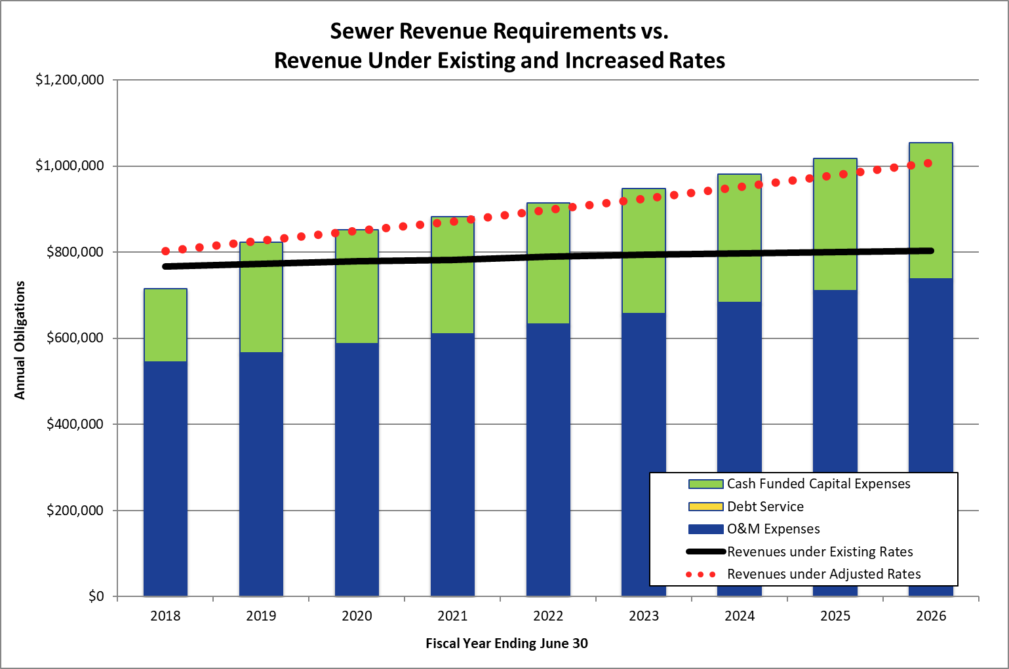
Financial Analysis
Notes:
CIP Funding is what is driving rate increases.
$250 annually (inflated at 3% annually)
O&M Changes – Payroll up (190k from 136k) Sewer Consulting Down (75k from 150k)

Slide 26
Financial Analysis, cont.

Slide 27
Financial Analysis, cont.

Slide 28
Rate Design

Slide 29
Water Utility
Proposed Rates

Slide 30
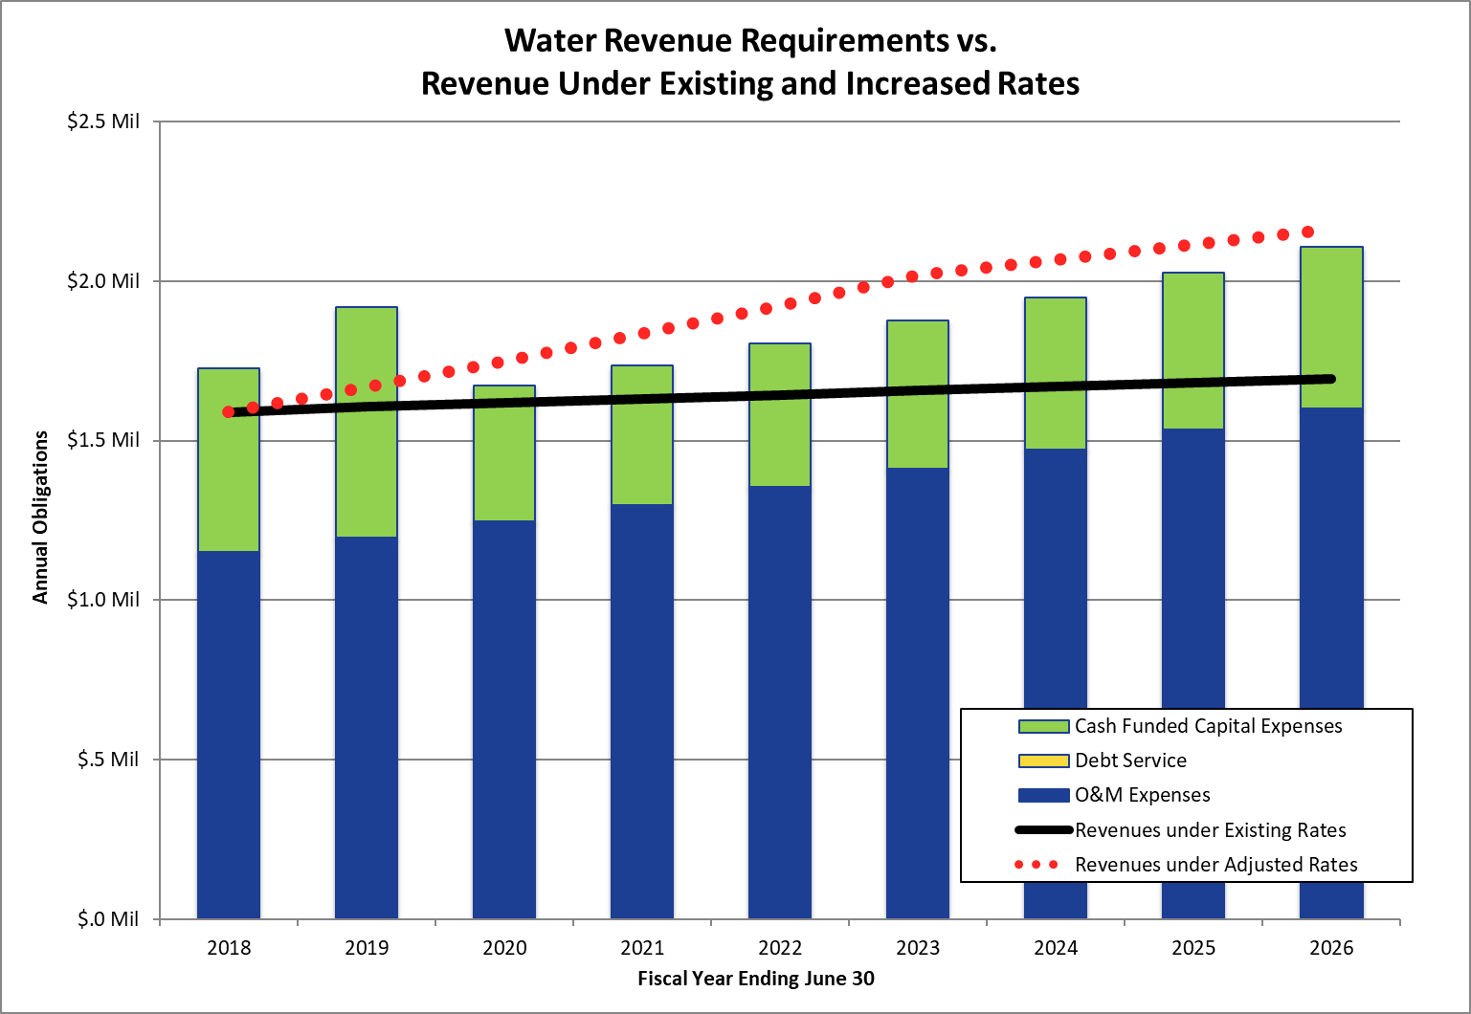
Financial Analysis
Notes:
CIP Funding is what is driving rate increases.
$700k 2018/19, $400k annually (inflated at 3% annually) thereafter.
O&M Changes – Payroll up (190k from 136k) Sewer Consulting Down (75k from 150k)

Slide 31
Financial Analysis, cont.

Slide 32
Financial Analysis, cont.

Slide 33
Rate Design
Notes:
Revenue allocation need not match cost allocation.

Slide 34
Consumption Distribution

Slide 35
Rate Design, cont.

Slide 36
Rate Design, cont.

Slide 37
Bill Impact

Slide 38
Bill Impact, cont.

Slide 39
Bill Impact, cont.

Slide 40

Questions and Answers

